Slide 1
Topic 2: For loop, Arrays, Strings,
CAB202 – Microprocessors and Digital Systems
Unit Coordinator: Luis Mejias Alvarez
Lecturer: Lawrence Buckingham

Slide 2
References

Slide 3
Practical C Programming
Chapter 4 – Basic declarations and expressions
Chapter 5 – Arrays, qualifiers, and reading numbers
Chapter 6 – Decisions and control statements
CPlusPlus.com Tutorial: Statements and flow control
CPlusPlus.com Tutorial: Arrays
TutorialsPoint: C Arrays

Slide 4
For loop

Slide 5
for (a;b;d){c}
The for statement is well suited to counting.
Four parts:
Initialisation statement: set up control variable(s).
Guard expression: decides whether the loop body will execute.
Body: statement, usually a {block} containing a sequence of statements.
Update statement: updates control variables,

Slide 6
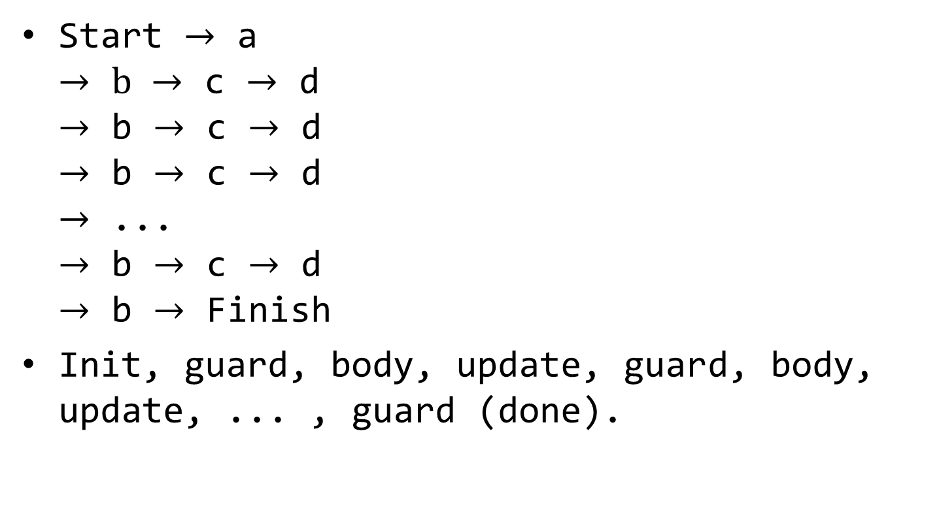
For loop execution sequence
Start $→$ a $→$ $b →$ c $→$ d $→$ b $→$ c $→$ d $→$ b $→$ c $→$ d $→$ ... $→$ b $→$ c $→$ d $→$ b $→$ Finish
Init, guard, body, update, guard, body, update, ... , guard (done).

Slide 7
For loop flow chart
Evaluate guard
!0
Initialise
Loop body
Update
0

Slide 8
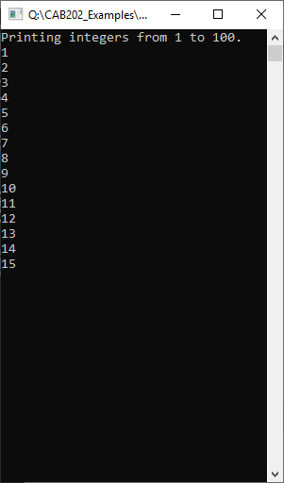
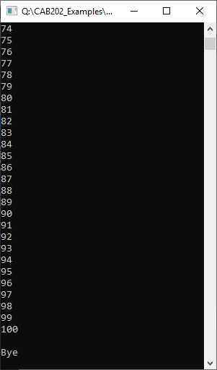
For loop example 1
Send the integers from 1 to 100 to standard output stream.
Results:

Slide 9
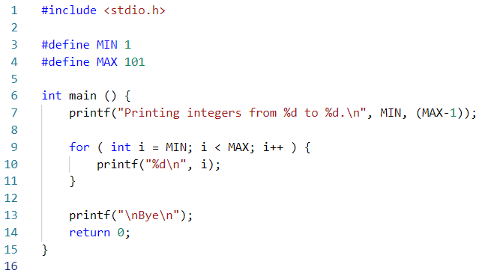
For loop example 1

Slide 10
Constant lower bound
Where I want to count from (inclusive)

Slide 11
Constant upper bound
Where I want to count to (exclusive)

Slide 12
Emit bounds of iteration to std. out

Slide 13
Initialise
Declare and initialise counter; only available in the loop.

Slide 14
Evaluate guard
Loop will exit when guard evaluates to 0

Slide 15
Execute body

Slide 16
Update

Slide 17
Evaluate guard
Loop will exit when guard evaluates to 0

Slide 18
Execute body

Slide 19
Update

Slide 20
Evaluate guard
Loop will exit when guard evaluates to 0

Slide 21
Execute body

Slide 22
Update

Slide 23
Evaluate guard
Loop will exit when guard evaluates to 0

Slide 24
Move on to the next instruction.
Finally... done

Slide 25
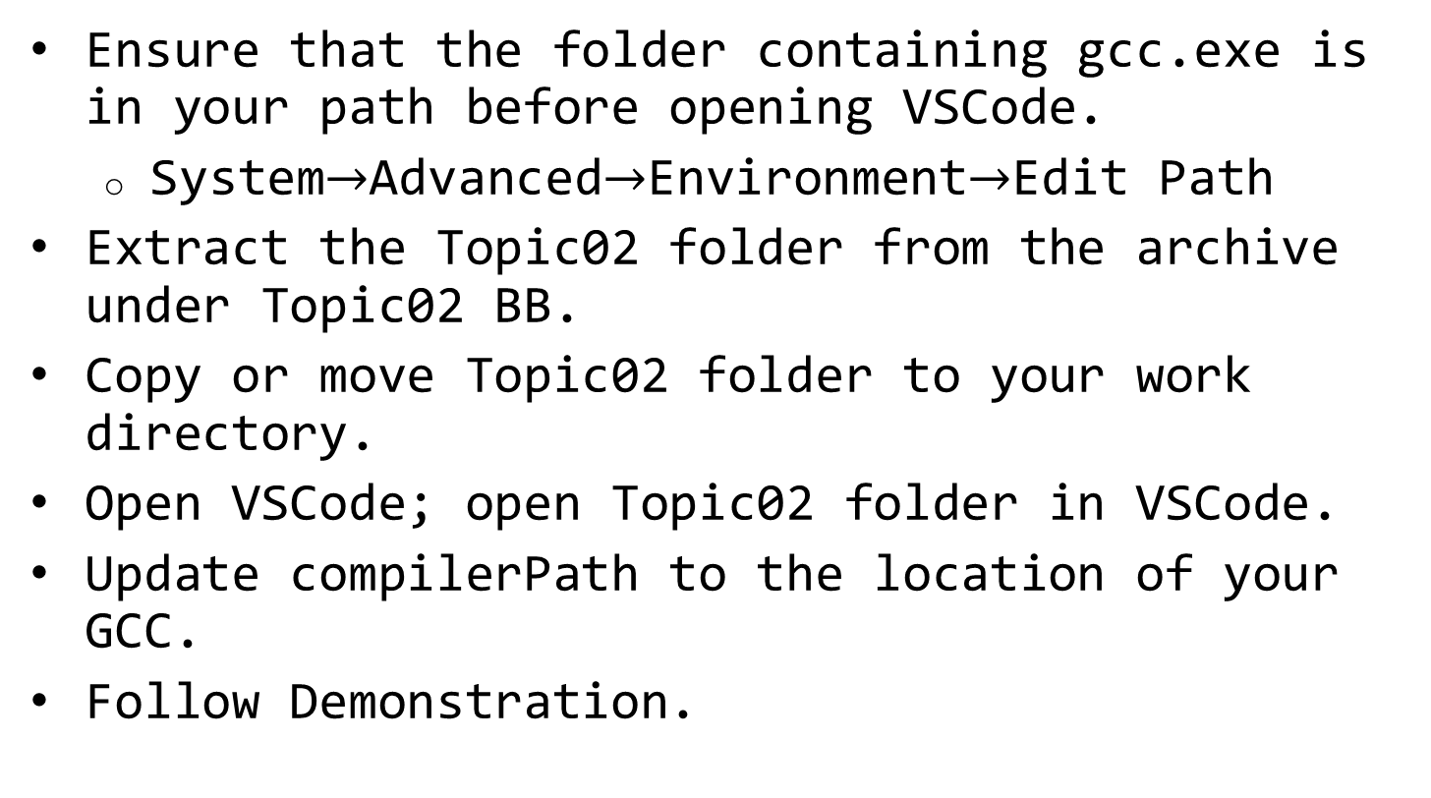
Single step the program in VSCode
Ensure that the folder containing gcc.exe is in your path before opening VSCode.
System$→$Advanced$→$Environment$→$Edit Path
Extract the Topic02 folder from the archive under Topic02 BB.
Copy or move Topic02 folder to your work directory.
Open VSCode; open Topic02 folder in VSCode.
Update compilerPath to the location of your GCC.
Follow Demonstration.

Slide 26
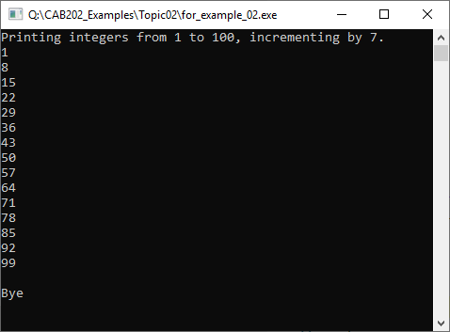
For loop example 2
Send the integers from 1 to 100 to standard output, skipping forward in steps of 7.
Results:

Slide 27
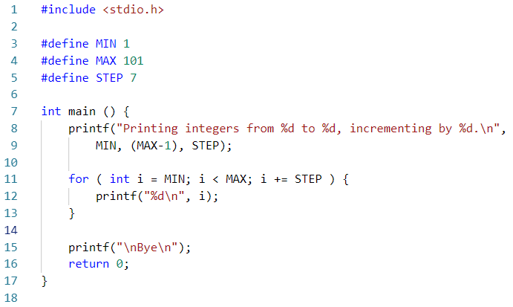
For loop example 2

Slide 28
Notes
Any of (a), (b), (c), or (d) may be empty.
e.g. for (;;) printf("CAB202 forever\n");
No initial action;
The guard evaluates as non-zero, so the loop never exits;
No update action;
Prints "CAB202 forever" forever.

Slide 29
If you want to count backwards:
Initialise clause: start at MAX
Guard clause: continue while greater than (or possibly greater-than-or-equal-to) MIN
Update clause: subtract instead of add (or add a negative STEP).
Watch out for off-by-one errors that may occur due to mix-up between < vs. <=, or > vs. >=

Slide 30
Multiple variables of the same type may be declared in the initialisation statement, and multiple actions can occur in the update clause.
e.g. for ( int i = 0, j = 100 - i; i < j; i++, j-- ) { printf("i = %d, j = %d\n", i, j); }

Slide 31
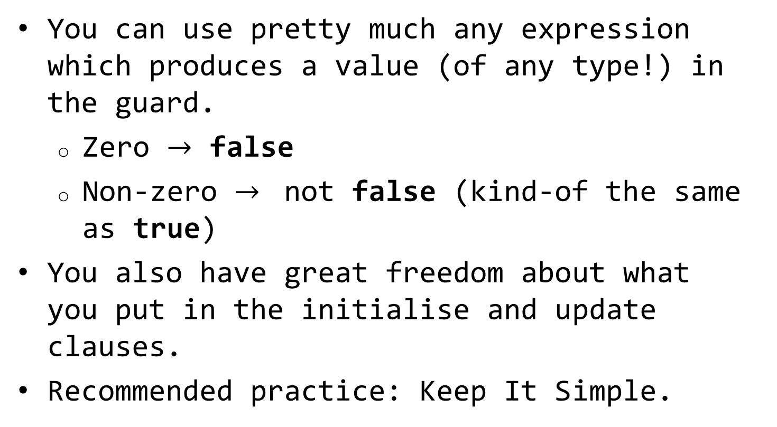
You can use pretty much any expression which produces a value (of any type!) in the guard.
Zero $→$ false
Non-zero $→$ not false (kind-of the same as true)
You also have great freedom about what you put in the initialise and update clauses.
Recommended practice: Keep It Simple.

Slide 32
Arrays

Slide 33
What is an array?
In C, array is a list of items.
The items in an array are called elements.
Elements of array are side-by-side in memory.
All elements in any given array are the same type.
Called the element type or the base type of the array,
Individual element of array is referenced by offset from the first element.

Slide 34
Example
int numbers[4] = {19, 32, -435, 67 };
Declare array of int, large enough to hold 4 values of that type.
Name of the array is numbers.
First element of the array has value 19, located at offset 0. It is referenced as numbers[0].
Last element of the array has value 67, and it is located at offset 3. It is referenced as numbers[3].

Slide 35
Memory map of an array
Its a mistake to thing the array somehow contains the elements - it doesn't
The array variable tells us where to find the data:
numbers
numbers[0]
numbers[1]
numbers[2]
numbers[3]

Slide 36
About the array declaration:
Must declare array before it can be used.
Including the capacity (maximum number of items you will refer to.
This needs to be big enough to hold the maximum number of items you ever want to store.
Problematic if the maximum number of items is not known in advance.
The capacity should be a compile-time constant expression (in Standard C).

Slide 37
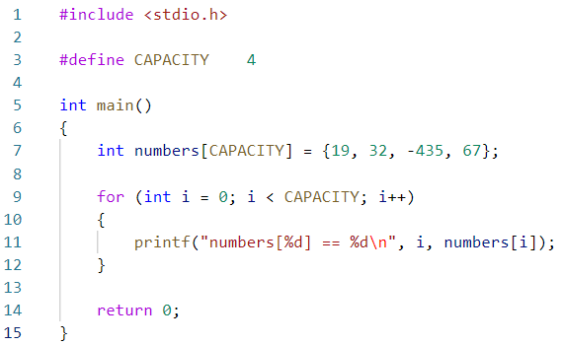
array_example_01.c

Slide 38
line 3: define array capacity

Slide 39
line 7(a): declare array with that capacity

Slide 40
line 7(b): populate array with initial data

Slide 41
line 9-12: use a for loop to traverse array

Slide 42
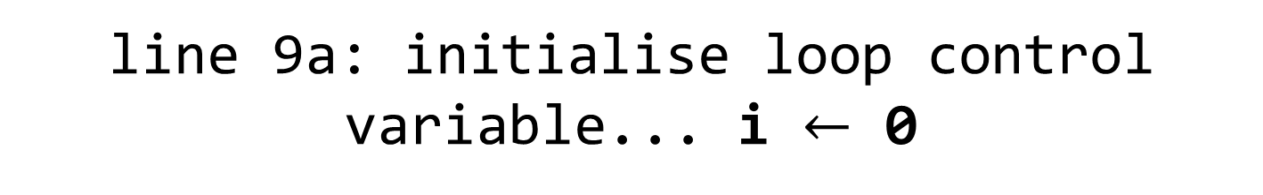
line 9a: initialise loop control variable... i $←$ 0
i
0

Slide 43
line 9b: evaluate guard... (i < CAPACITY) == 1 (loop will continue)
i
0

Slide 44
line 11: Emit numbers[0] == 19 to standard output
i
0

Slide 45
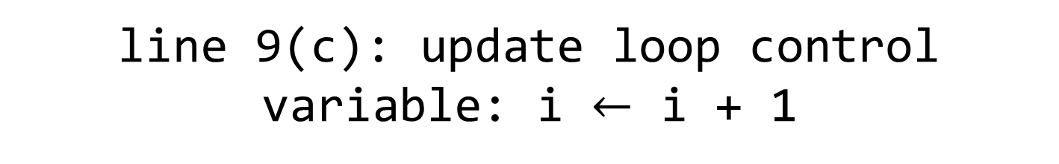
line 9(c): update loop control variable: i $←$ i + 1
i
1

Slide 46
line 9b: evaluate guard... (i < CAPACITY) == 1 (loop will continue)
i
1

Slide 47
line 11: Emit numbers[1] == 32 to standard output
i
1

Slide 48
line 9(c): update loop control variable: i $←$ i + 1
i
2

Slide 49
line 9b: evaluate guard... (i < CAPACITY) == 1 (loop will continue)
i
2

Slide 50
line 11: Emit numbers[2] == -435 to standard output
i
2

Slide 51
line 9(c): update loop control variable: i $←$ i + 1
i
3

Slide 52
line 9b: evaluate guard... (i < CAPACITY) == 1 (loop will continue)
i
3

Slide 53
line 11: Emit numbers[3] == 67 to standard output
i
3

Slide 54
line 9(c): update loop control variable: i $←$ i + 1
i
4

Slide 55
line 9b: evaluate guard... (i < CAPACITY) == 0 (loop ENDS)
i
4

Slide 56
line 11: return 0 and finish.

Slide 57
Array example 2
Interactively read a list of floating point values from standard input. Compute the sum of the values. Display the result.
Declare a global array with capacity to store 100 floating point values.
Ask user how many values.
Read that many values.
Compute the sum of the values stored in the array.
Send the result to standard output.

Slide 58
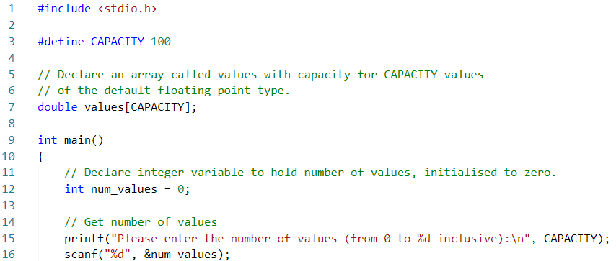
Array example 2

Slide 59
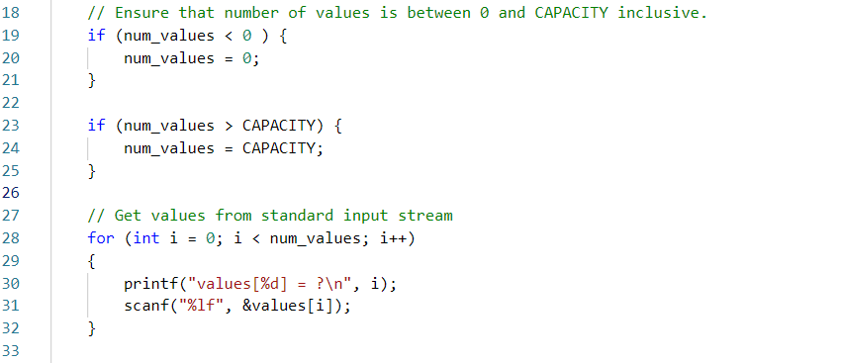

Slide 60
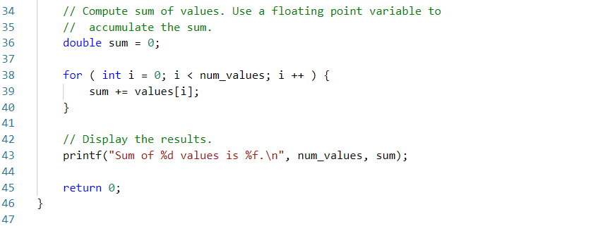

Slide 61
Strings

Slide 62
Strings are arrays of char
C doesn't have a proper "string" data type.
The double-quote notation is a compact way to declare and initialise an anonymous char array.
Standard library functions defined in <string.h>
strlen – returns the length of the string.
strcpy, strncpy – copy contents of string.
strcat, strncat – concatenate strings.
See http://www.cplusplus.com/reference/cstring/.

Slide 63
A string literal, such as "Lawrence", is a compact way of declaring an array of char.
The following declarations are all exactly equivalent. Each of them defines and populates an array of 9 characters, which contains the string Lawrence.
char s[9] = "Lawrence";
char s[] = "Lawrence";
char *s = "Lawrence";
char s[] = { 'L', 'a', 'w', 'r', 'e', 'n', 'c', 'e', 0 };
char s[9] = { 'L', 'a', 'w', 'r', 'e', 'n', 'c', 'e' };

Slide 64
In practice...
We are almost totally unconcerned with strings in CAB202.
This unit is about microprocessors, not general purpose programming.
Therefore, we will cover minimal C to enable you to complete the microcontroller part of the course.
So you need to know only the basics about how to process the char data in a string.
Which is: just like any other array of small integer values.

Slide 65
Pitfalls

Slide 66
Buffer overruns
C does not implement run-time bounds checking.
We can use any int-valued expression to access memory in and around the array.
numbers[-1]
numbers
numbers[0]
numbers[1]
numbers[2]
numbers[3]
numbers[4]

Slide 67
Why might that be a problem?
The memory near our array is probably being used for something else!
We can read or write numbers[-1], but that will trash some other piece of data.
The data we trashed is almost certainly needed for some other important purpose.
If it wasn't important, we would not have it in the first place.
If we are lucky, the program will crash.
Segmentation fault is your best friend!

Slide 68
End

